Slide 1

CITIZEN PROCESSING SYSTEM
Presented by:
Quantum Quirk

Slide 2
Problem Statement
Citizens notice potholes, broken streetlights, and water leaks around Hyderabad. However, they have no simple way to report these issues to city authorities. City workers cannot view all complaints sorted by area or type, so they are unsure about which problems require urgent attention. Additionally, no one can monitor whether reported issues are actually resolved.

Slide 3
Proposed Solution
We built a web backend that allows citizens to report potholes and water leaks using apps or WhatsApp. The system sorts complaints by category and status. City workers can see urgent issues and update them from open to resolved. It is made with Python Flask and SQLite, and it is available for free on render.com for round-the-clock access.

Slide 4
Objectives
Enable citizens to easily report city issues through mobile apps, WhatsApp, or SMS.
Organize complaints by category, such as potholes, water leaks, and street lights, as well as by location.
Allow city workers to filter and view urgent open issues.
Track the status of issues from "open" to "resolved" with timestamps.
Deploy a free system that is always online and accessible 24/7.
Create analytics that show fix times and the distribution of issues.

Slide 5
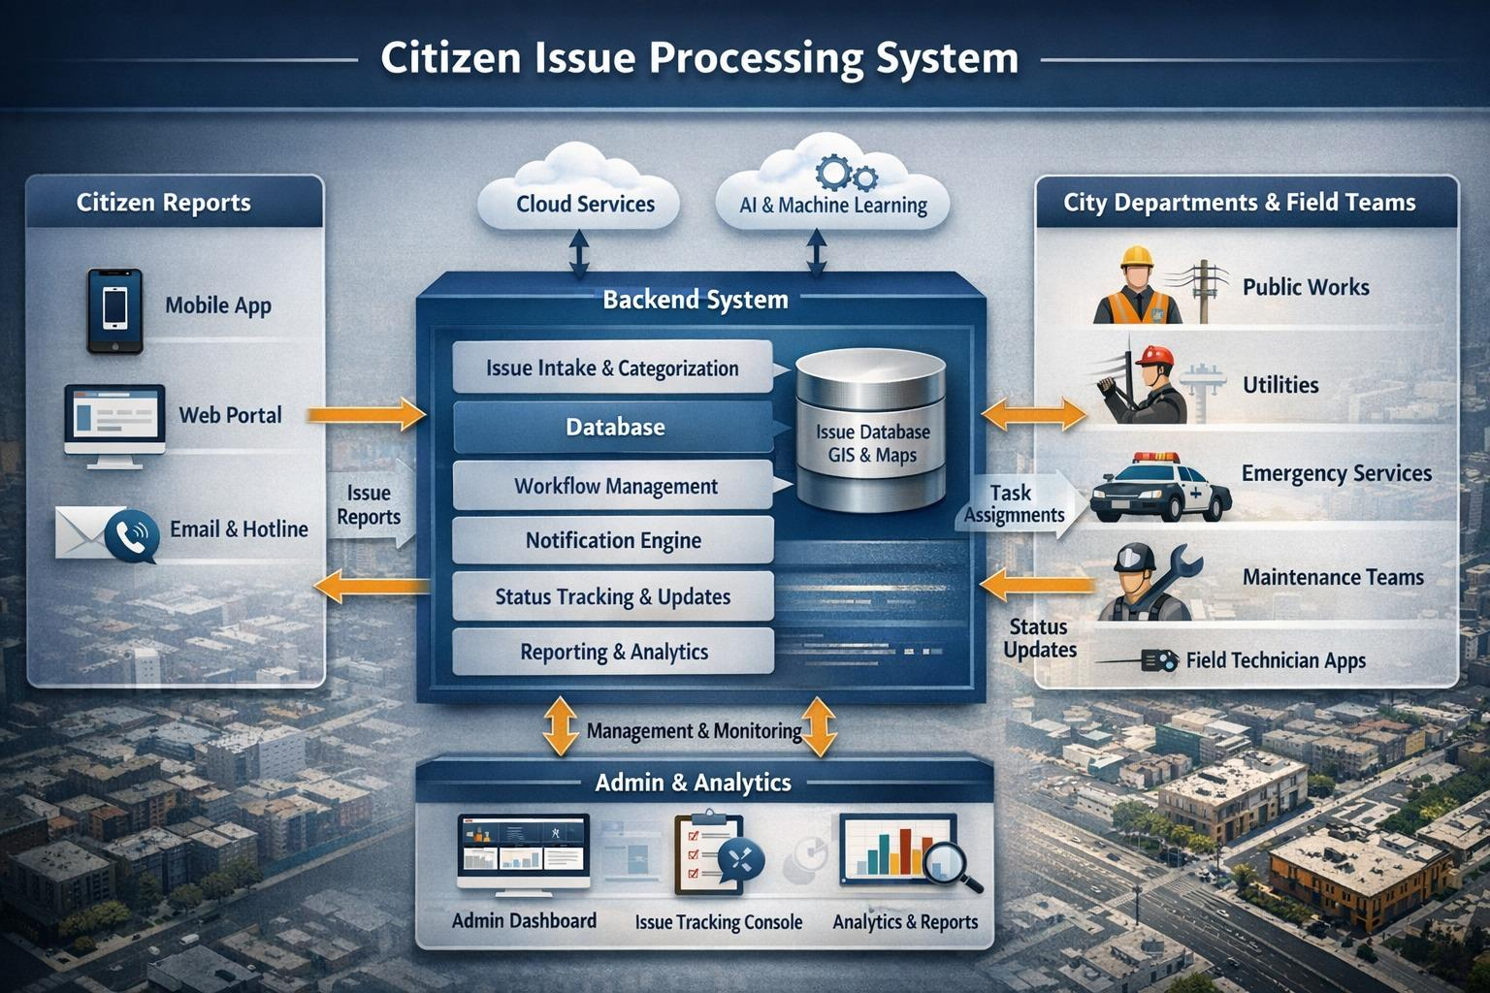
System Architecture

Slide 6

Technical Workflow
Citizen reports the issue through Mobile or Web. The report includes a description, category, GPS location, and media.
The backend checks the details and creates an Issue ID.
The system automatically sends the issue to the right department.
A technician fixes the issue and updates the status from Assigned to Resolved.
The citizen gets real-time updates.

Slide 7
Features
Citizen reporting through apps, WhatsApp, and SMS
Organized by category: Pothole, Water Leak, Street Light
Status tracking: Open, Resolved
Filter by status or category: ?status=open
REST API: POST, GET, PATCH
24/7 deployment on render.com
Mobile app provides JSON responses

Slide 8
Technologies Used
Backend: Python 3.11, Flask framework
Database: SQLite, production scalable to PostgreSQL
ORM: Flask-SQLAlchemy, database models
API: RESTful JSON endpoints (/api/issues)
Server: Gunicorn, production deployment

Slide 9
Results
3 test issues successfully stored: 2 potholes and 1 water leak.
Status tracking is working, with 1 resolved and 2 open.
Category filtering is functional, with Pothole assigned to ID1 and Water Leak to ID2.
The API endpoints are operational:
GET /api/issues lists all complaints.
POST /api/issues creates new reports.
PATCH /api/issues/1 updates the status to resolved.
The homepage is deployed with manual navigation links. There is zero downtime during local testing, which runs on python app.py.

Slide 10
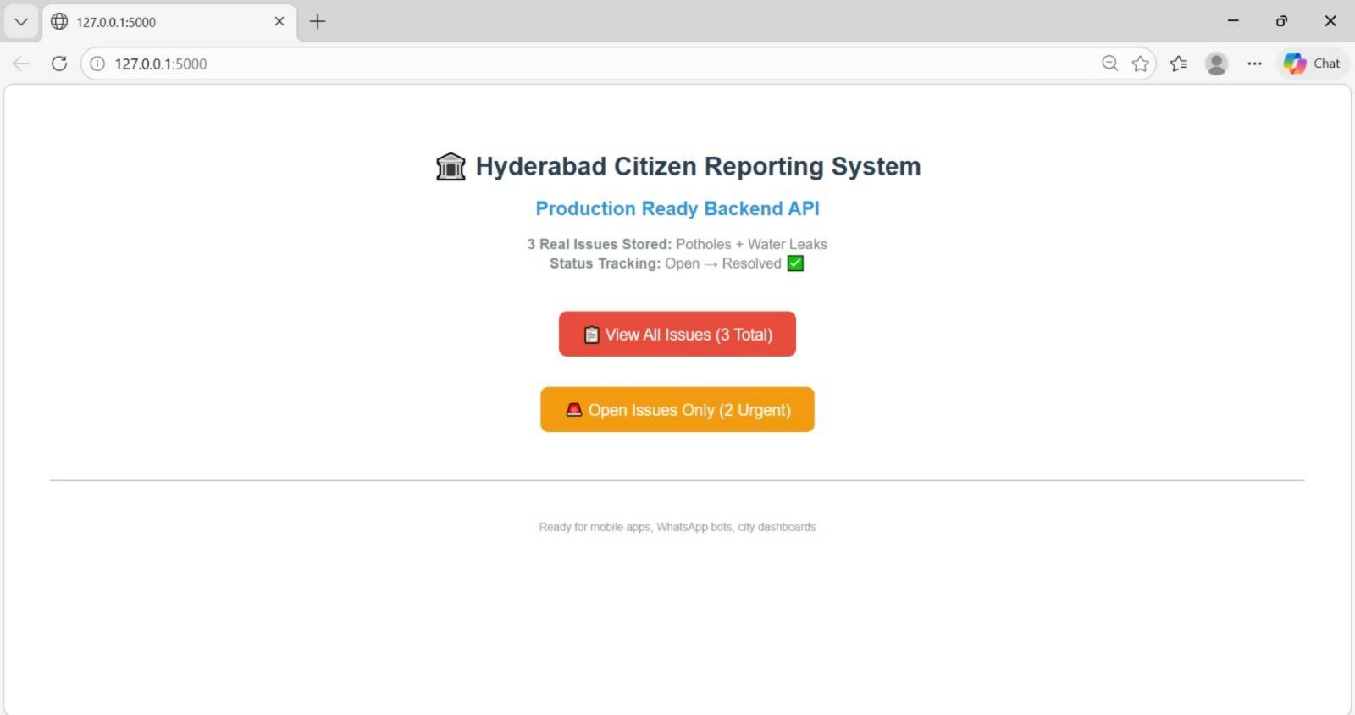

Slide 11
Conclusion
We created a complete citizen issue reporting backend with Flask. This system allows easy reporting of potholes, water leaks, and street lights through mobile apps, WhatsApp, and SMS. City workers can access organized complaints and track their status from open to resolved. They can also filter by category and urgency. The ready-to-use system deploys quickly on render.com, creating an efficient workflow that improves maintenance and response times for Hyderabad's infrastructure.

